Slide 1
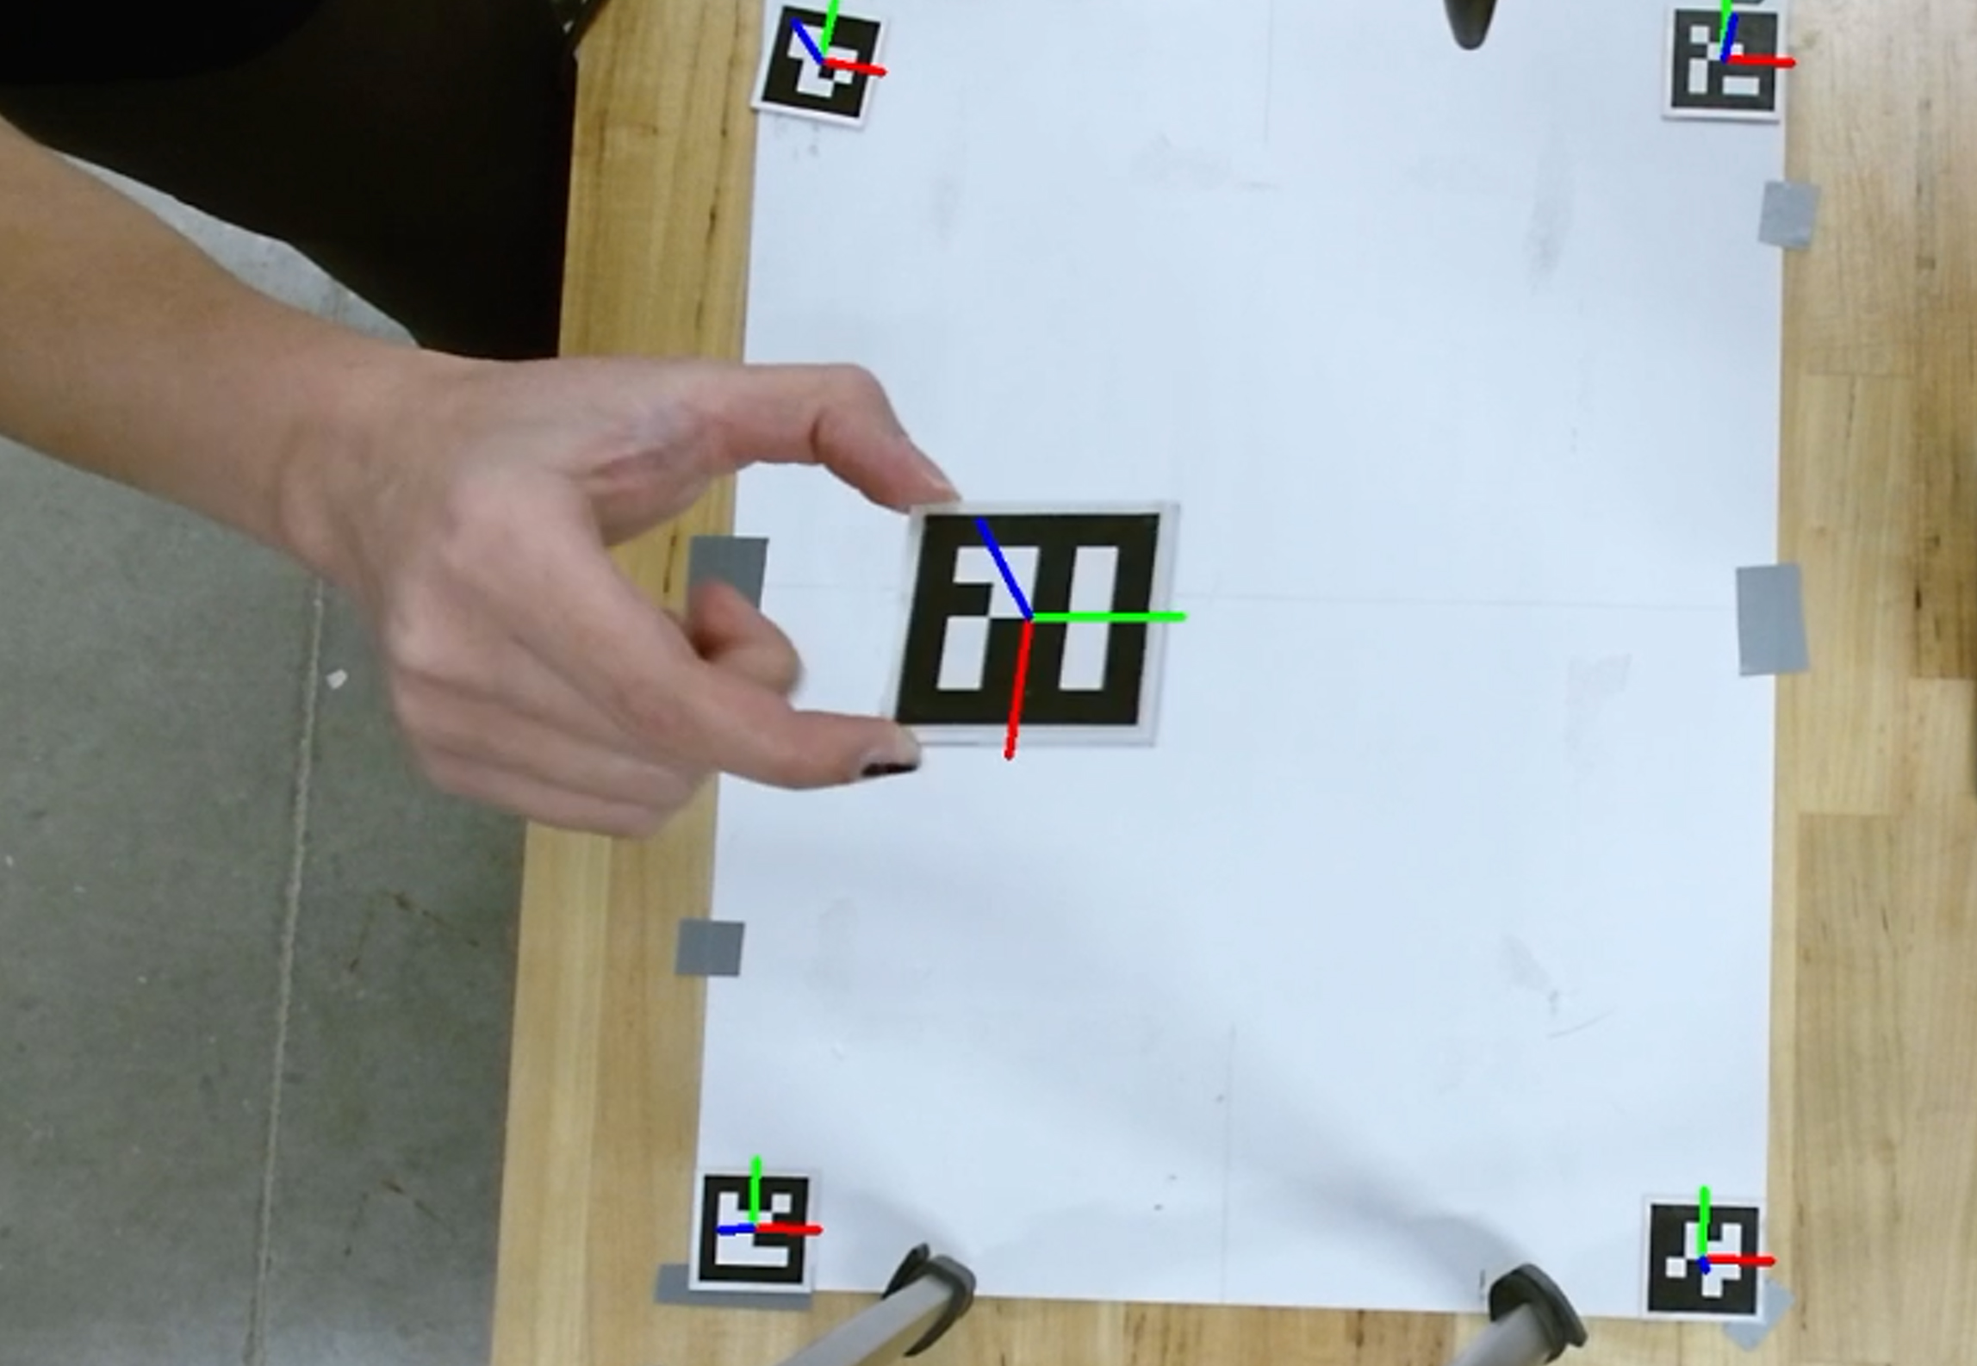
Detect Aruco markers by using esp32cam
Distinctive patterns
Camera calibration
Object tracking
OpenCV support

Slide 2
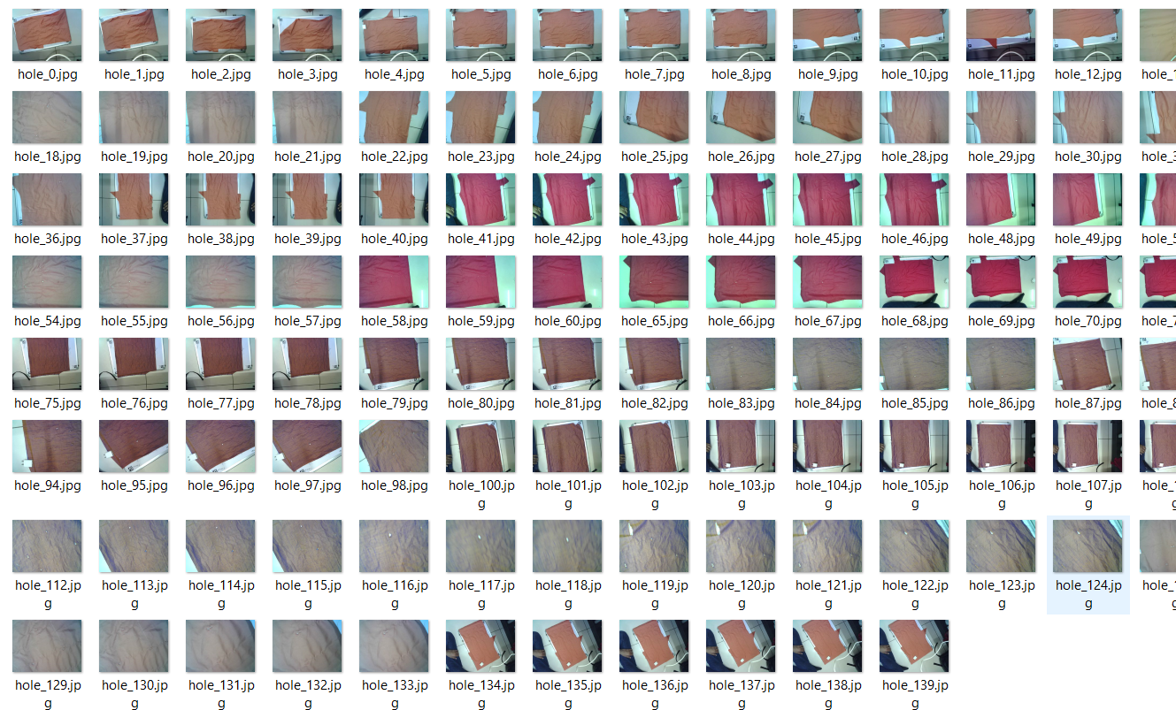
2. Creating and Training a Dataset for Object Detection
Data Collection and Acquisition.
Data Labeling and Annotation
Splitting the Dataset
Choosing a Machine Learning Algorithm
(e.g., regression, classification, clustering).
Model Training (using YOLO)

Slide 3
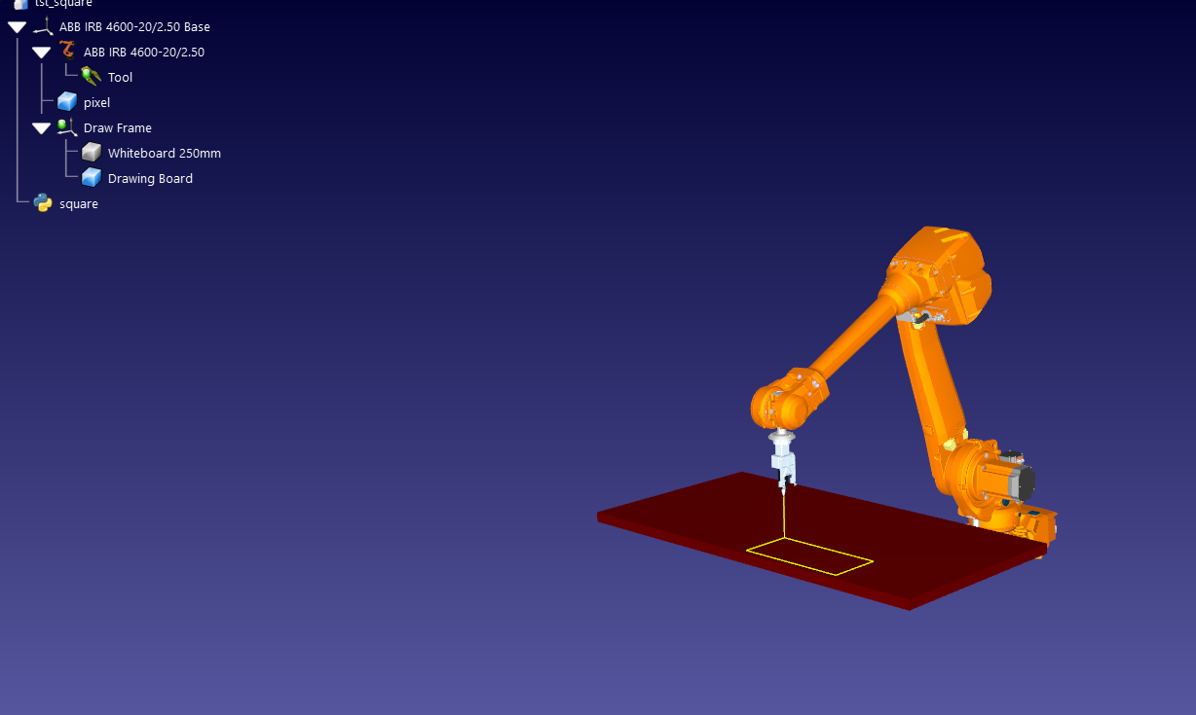
3. Robot Simulation
Initializing
Creating a Working Area
Camera Detection
Image Processing
Detection the working Area

Slide 4
